Slide 1

Data Modeling Exercise
Name: Harikrishnan Shajil
Applying for: Data Analyst

Slide 2
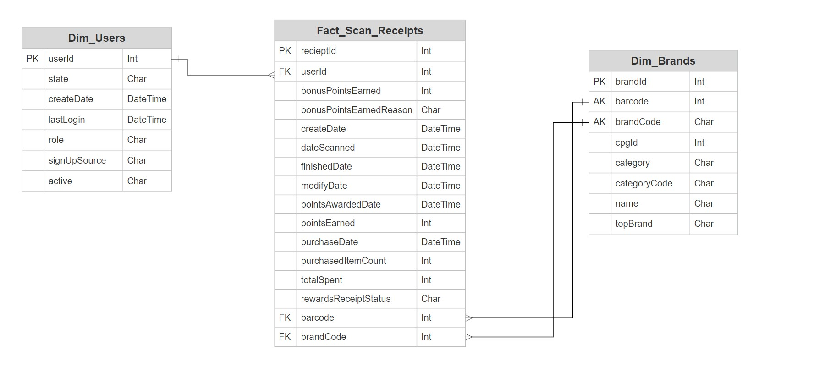
Part I: Data Modeling
Initial Logical Data Model using Ralph Kimball approach
Denormalized model

Slide 3
Ralph Kimball Approach
Pros:
User friendly model
Allows easy reporting
No upfront work, incremental development
Cons:
Storage issues
Redundancy (for ex: duplication of records in fact_scan_receipts)

Slide 4
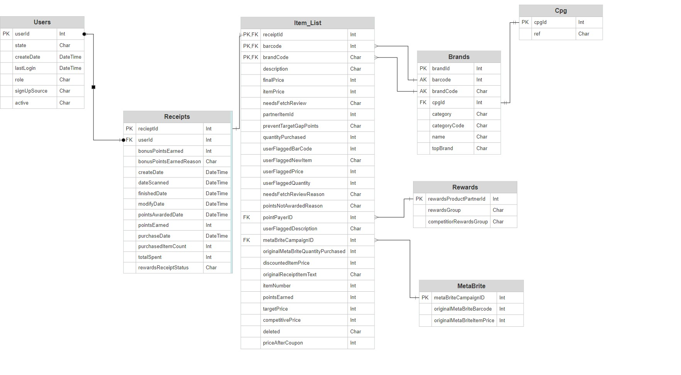
Part I: Data Modeling
Final Data Model using Bill Inmon approach
3NF model

Slide 5
Bill Inmon Approach
Pros:
Less storage and optimized
Less redundancy
Easier to model
Cons:
Slower reporting (for ex: more joins and processing time to retrieve data)
Upfront work needed - business requirements needed prior to building

Slide 6
Bill Inmon Approach
Additional entities created to remove transitive/partial dependcies:
Item_Lists – each record contains brand information (redundant records)
Rewards – rewards partner group information
MetaBrite – for varying campaign prices
CPG – can be used to add cpg related information

Slide 7
Part III: Data quality Issue
Initial Setup & Packages:
JSON files imported using R
Used stream_in() function from jsonlite package since data was new-line delimited (ndjson format)
Packages used: jsonlite, dplyr, tidyr

Slide 8
Part III: Data quality Issue
Data Manipulation:
Added columns ReceiptId and UserId due to difficulty in column name referencing
Collection rewardsReceiptItemList is read in as dataframe within main dataframe receipts
Separated out rewardsReceiptItemList as a stand-alone table
Column names for rewardsReceiptItemList is computed using all unique column values from the collection

Slide 9
Part III: Data quality Issue
Data Exploration:
Brands:
Number of instances: 1167
Number of unique barcodes: 1160
7 barcodes duplicated
Users:
Number of instances: 495
Number of unique users: 212
283 users duplicated
Receipts:
Outliers detected in columns – bonusPointsEarned & purchasedItemCount
Columns – pointsEarned & totalSpent have Char datatypes

Slide 10
Part III: Data quality Issue
Final Takeaways:
A single source truth - users & brands dataset need to be formed with unique IDs for merging operations
A well-structured dataset need for rewardsReceiptItemList
Barcode “4011” to be added to brand database
Brand uuid can be used as a uniquely identifying column and serve as Primary Key

Slide 11
Next steps:
Deep dives analysis:
Are the scanned barcodes getting right value?
Is pointsEarned correlated with total spending?
Can a cluster of users be created based on user information (state, type, active)?

